Slide 1
WE TAKE ENERGY
FROM NATURE’S SOURCE
Innovative and sustainable – because we care about the future.

Slide 2
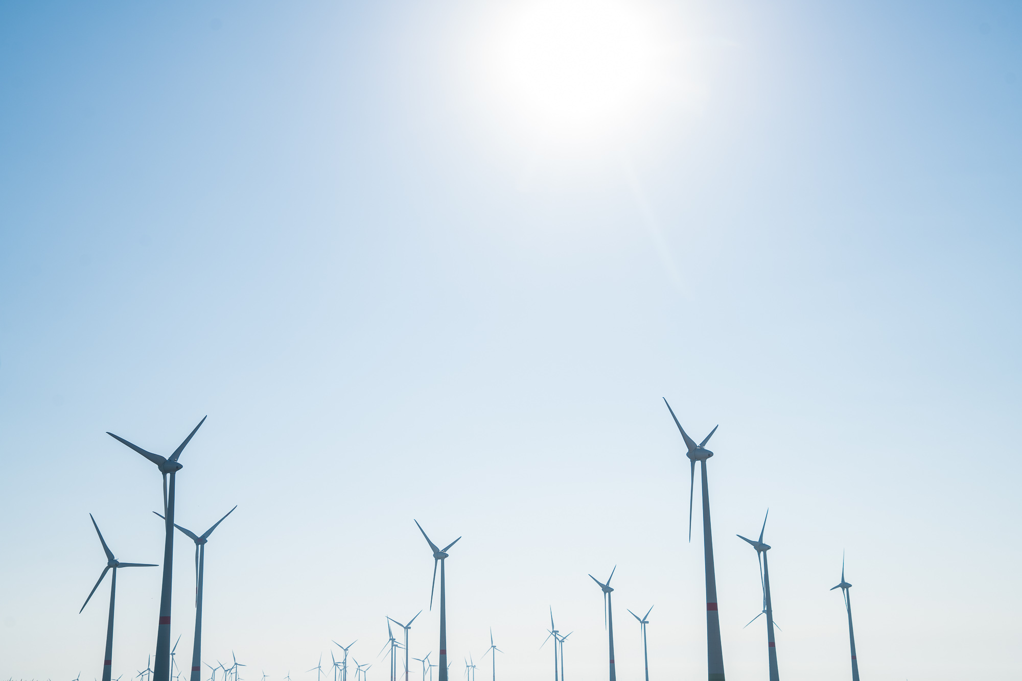
Your Partner in the Energy Revolution.
Powered by Nature.

Slide 3
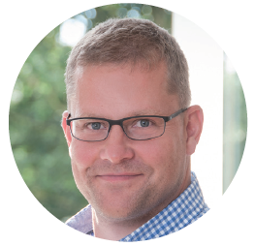
Our vision
Wind, sun and biomass are everywhere. We believe that the future
belongs to renewable energies and make a point of looking
at the big picture. Our company is a valuable contact for anyone
who wants to work with green energy.
For the benefit of the environment and future generations.
MICHAEL RASCHEMANN Managing Director

Slide 4
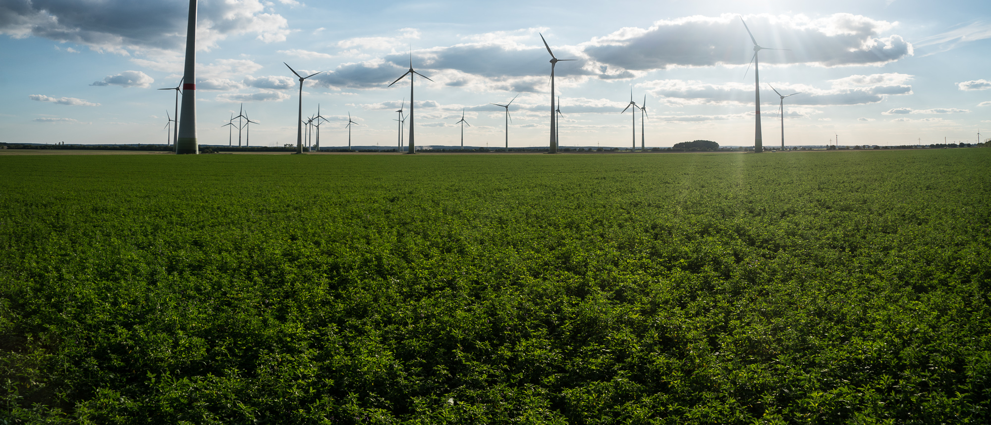
A Success Story
Founded in
1997
More than
500
staff
More than 20
office locations
INTER-
national
100 %
customer
satisfaction

Slide 5
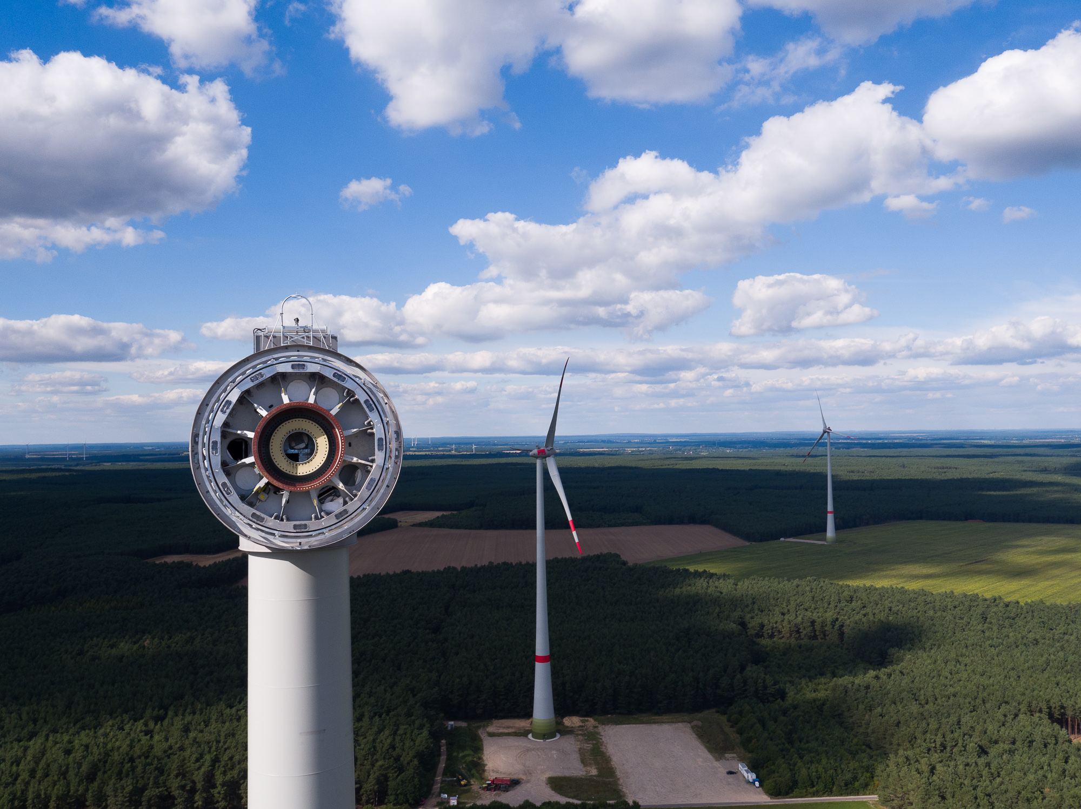
Installed systems since 1997
Wind Energy more than 800 WTGs in Germany, France,
Finland & Poland
1.385 MW
Photovoltaics
More than 30 photovoltaic plants 85 MWp
Biogas
1 biogas plant in Germany
12 MW of electric power
Power Grid Operation
22 high-voltage substations
in Germany
with 1.823 MVA
Storage
1 energy storage facility in Germany 10 MW

Slide 6
Our services
Project Development
Planning and construction of plants
for tapping renewable energies.
Financing and Sales
Project financing and attractive opportunities for investors
Operational Management
Technical and commercial management, supervision and operation of system.

Slide 7
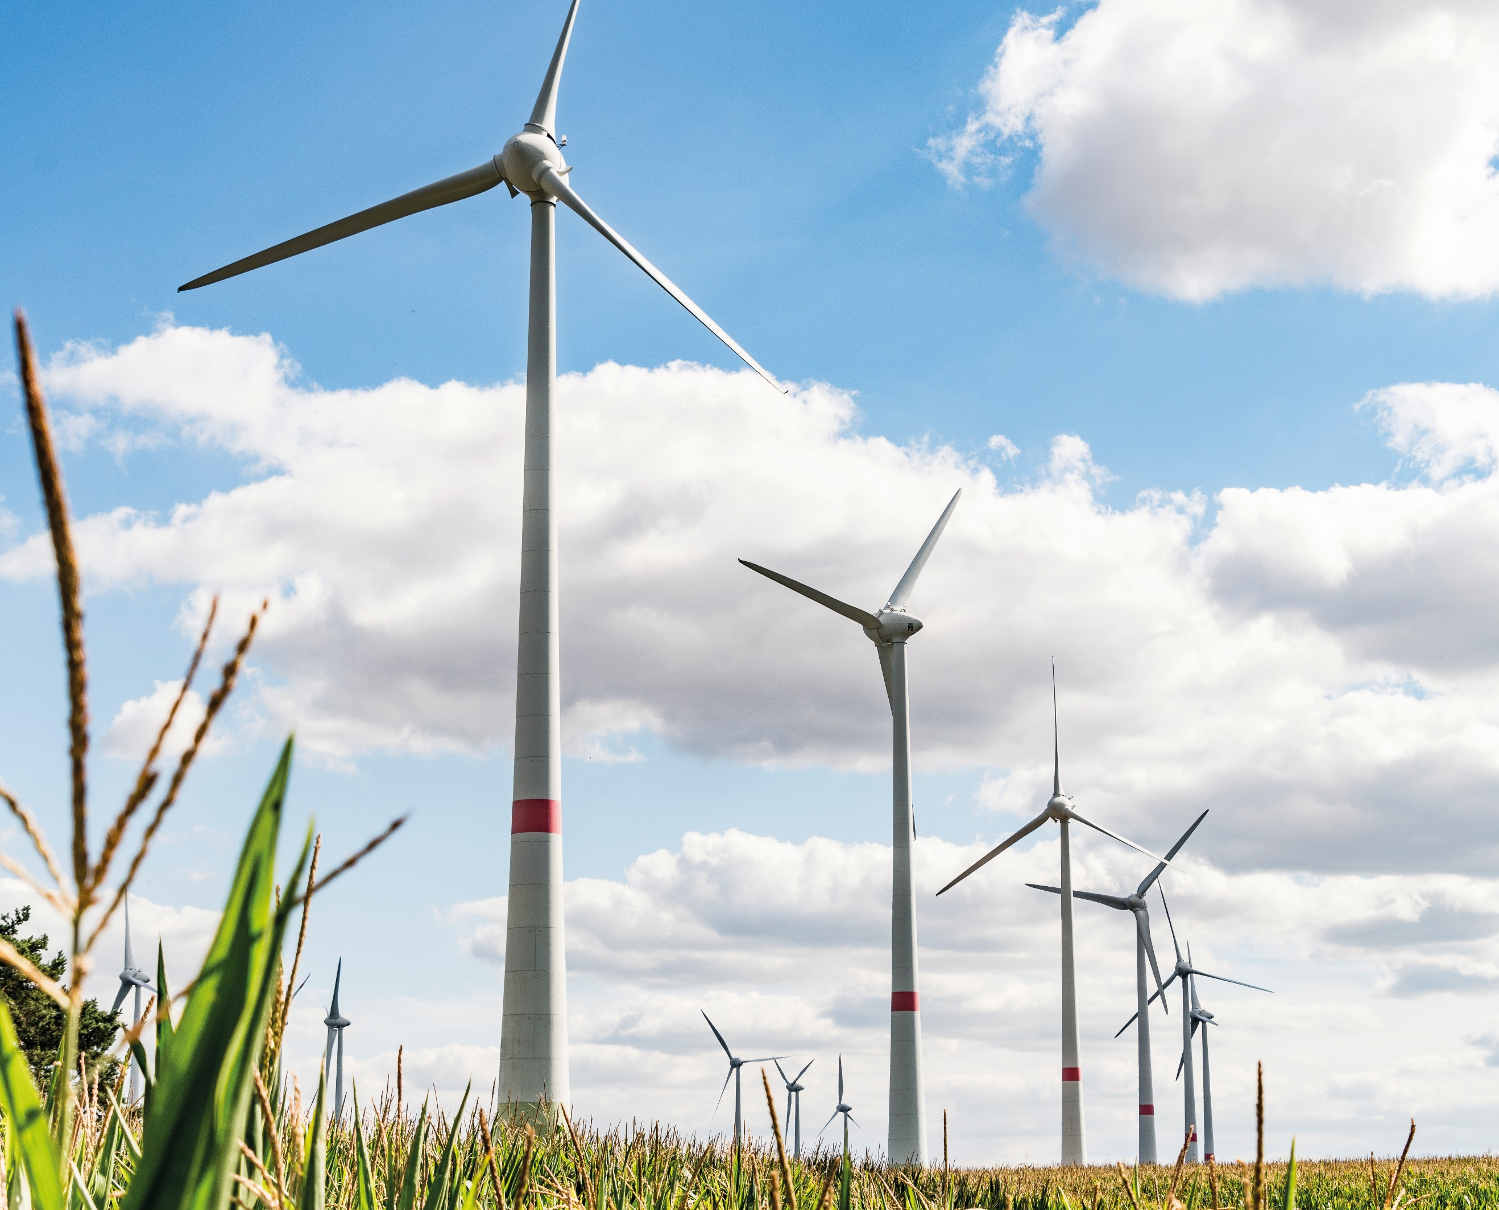
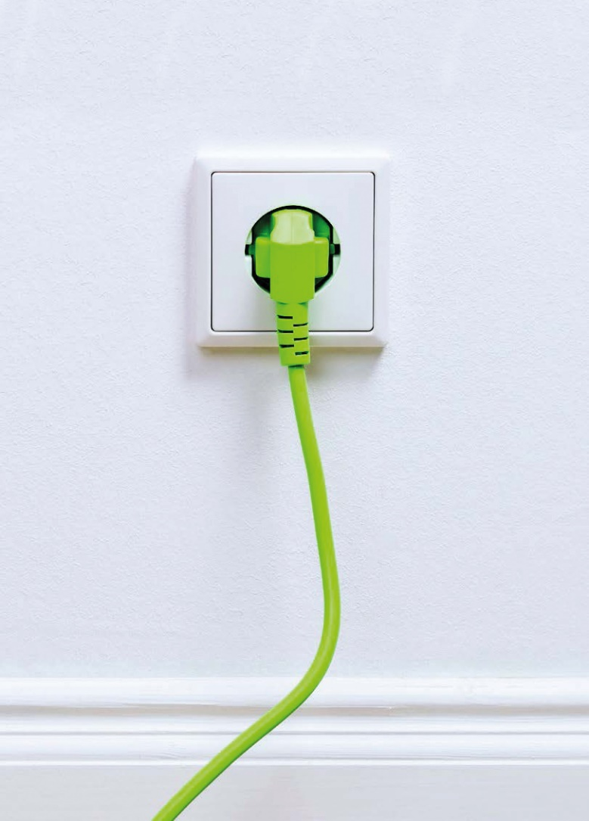
Our business areas
Wind
Photovoltaics
Biogas
Energy Storage
Grid Connection
Electricity Sales
Innovation
Innovation

Slide 8
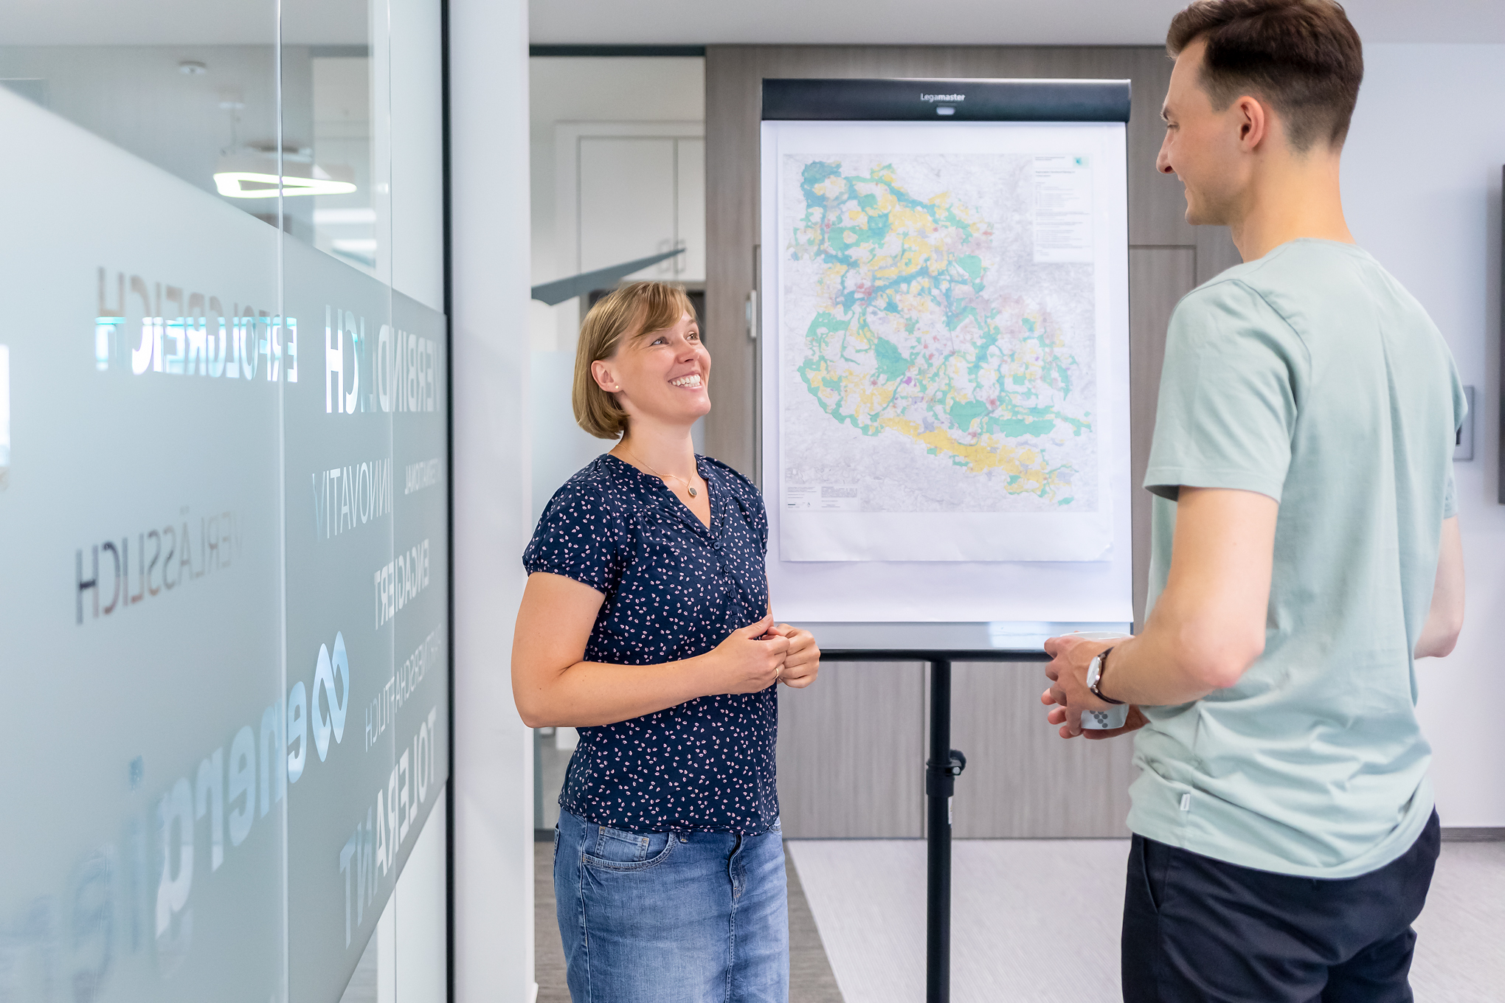
Project development

Slide 9
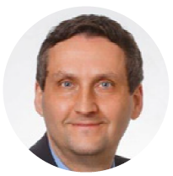
Project development
Energiequelle handles all steps for creating and operating
renewable energy systems – everything from securing property
rights, navigating the complex process of obtaining the
necessary permits and licences, to building and commissioning
renewable energy plants.
We are the point of contact for landowners,
local communities, governments and investors.
We also help our partners with existing projects.
Extensive experience, transparency, fairness and
proven project management skills are the foundation
of our work.
Personally. Innovative. Reliable.
MICHAEL KNAPE Mayor of Treuenbrietzen
With Energiequelle, we have an open and long-sighted partner at our side that we can deal with as equals. I greatly appreciate their reliability, experience and cooperative attitude, together with their well-developed ability to respect the ‘unique essence’ of our town and the surrounding villages. And this view is shared by the entire community. Working together, we have paved the way for a new
future in Treuenbritzen and Germany!
Notes:
Energy concepts for local governments
Site finding and analysis
Securing of land
Project planning
Construction management and installation
Grid planning, implementation and connection

Slide 10
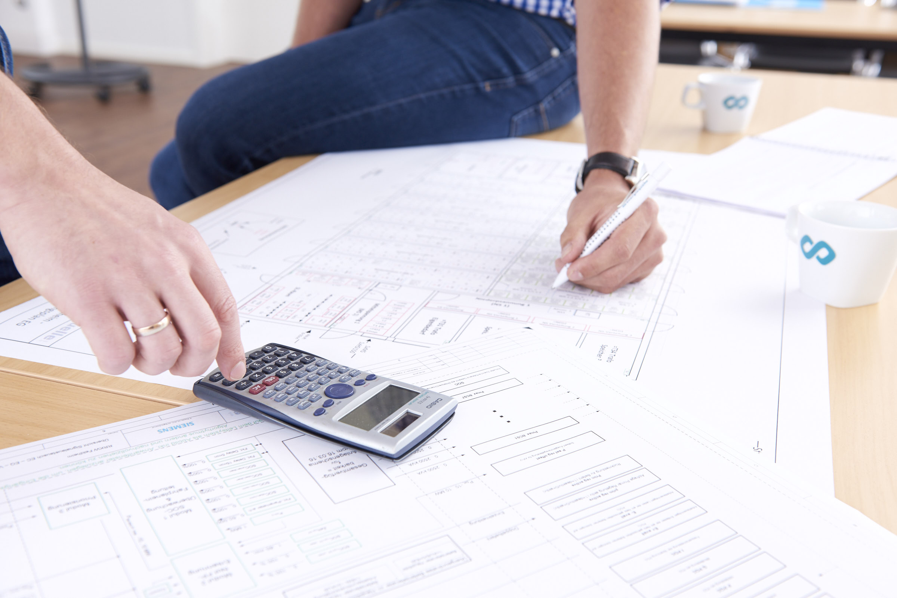
Financing and Sales

Slide 11
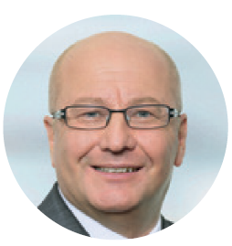
Financing and Sales
We are a well-networked and a financially strong company.
We have in-depth knowledge of the market for renewable energies.
Our sales representatives also cultivate good long-term relationships
with banks and investors. This results in innovative, specially
tailored financing solutions for our projects in Germany and
other countries.
We will be happy to persuade you personally.
FRANK ELOY Member of the Board of Directors of SaarLB
We have been actively involved in renewable energy projects since 2003 and have been working very successfully with Energiequelle for eight years now. During this time, we have jointly implemented systems with a total power output of nearly 150 MW in Germany and France. Apart from project financing, Energiequelle has also been one of our bank’s corporate customers for many years. Our relationship is characterised by professionalism and trust.

Slide 12
Operational Management

Slide 13
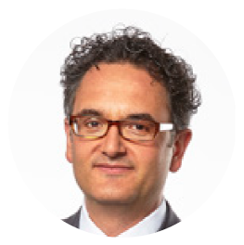
Wind Energy More than 800 WTGs in Germany, France and Finland
1.396 MW
Operational Management
Photovoltaics
More than 30 photovoltaic plants
in Germany and France
83 MWp
We take care of your renewable energy system.
Around the clock and support from A to Z.
We provide the full range of technical support for renewable energy systems, including swift and decisive action if there are any malfunctions or if any other repair or servicing work is urgently needed.
Professional and qualified.
Biogas
1 biogas plant in Germany
Generation of 1,61 MW of electric power
THOMAS STAUDINGER Managing Director of re:cap global investors ag in Zug, Switzerland
With our investors in mind, we chose Energiequelle as partner not only because they know what they are doing, but also because we can count on them to deliver full-scale, reliable support over the long haul, all the way from asset acquisition to the operational management phase. This way we always know that our investments are in good hands.
Power Grid Operation
25 high-voltage substations in Germany with 2.072 MVA
Storage
1 energy storage facility
in Germany 10 MW
Notes:
Managed systems Germany
Wind: 596 systems (1047.4 MW)
PV: 21 systems (55.3 MW)
Biogas: 3 systems (1.6 MW)
Substations: 21 substations (1,765 MVA)
Europe
France: 80 WTGs (157.4 MW)
Italy: 6 PV (5.9 MW)

Slide 14
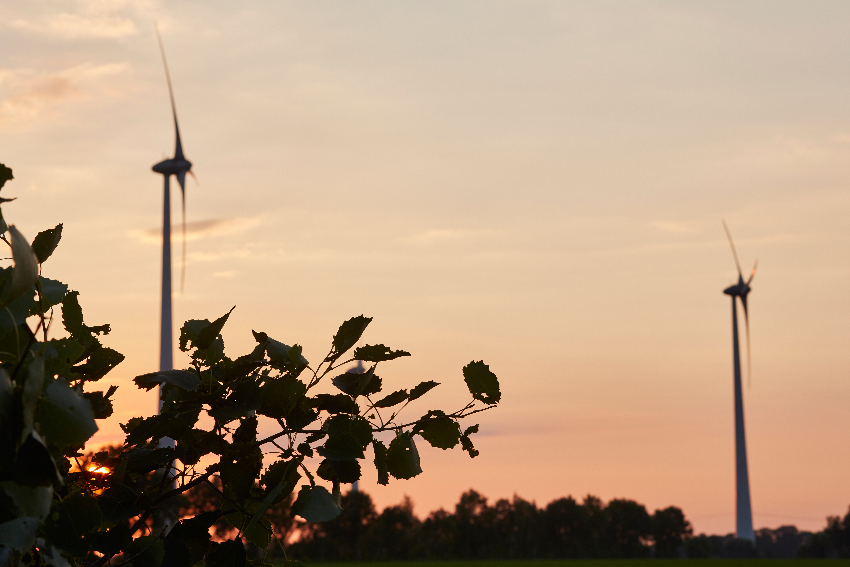
REFERENCES
And proud of it.

Slide 15
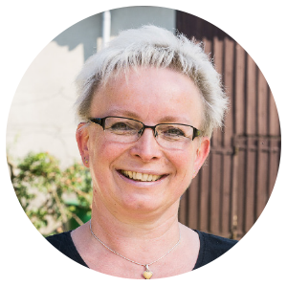
Energy self-sufficient village of Feldheim
In the Brandenburg village of Feldheim, Energiequelle has implemented
one of the most spectacular concepts for decentralised renewable energy supply.
Households and businesses in the village are supplied with heat and power from
wind and biogas power plants at their own doorstep.
Energiequelle has planned and installed this turnkey, self-sufficient energy supply system, and finally connected it via the new heat and power distribution system to form
a regional energy supply grid.
PETRA RICHTER Mayoress of Feldheim
We’re proud of what we have
achieved in Feldheim with Energiequelle.
Our energy self-sufficiency
puts us in an excellent position for
mastering the future and provides
our children and grandchildren
with an eco-friendly supply of power
and heat. This is our contribution
to the energy transition.

Slide 16
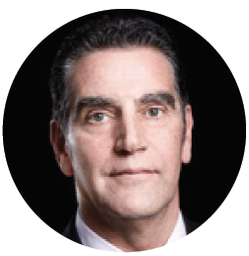
Flagship project RRKW
Energiequelle has completed installation of the biggest ever battery storage system in Germany at the time, in a joint project with its partner, Enercon. The official name of the battery power station is the ‘Feldheim Regional Regulating Power Station’ (RRKW). The RRKW has been built in the immediate vicinity of the Feldheim wind farm in Brandenburg. A total of 3360 lithium-ion modules provide 10 MW of controlling power and 10.7 MWh of power production. The battery storage system is used to provide load-balancing power in the transmission grid of 50 Hertz, the grid operator. It is able to balance out variations in grid frequency within milliseconds.
HANS-DIETER KETTWIG Consultant Enercon GmbH
In many ways, good project management is essential for wind energy projects. As a manufacturer, we are very pleased to have found in Energiequelle a business partner that we can rely on to handle projects of this kind. In everything we’ve done together, we’ve consistently felt Energiequelle’s reliability, honesty, and strong commitment to quality. We are very
grateful to them for that reason.

Slide 17
Race track „Green Lausitzring“
In the immediate vicinity of the Lausitzring race track (Brandenburg), Energiequelle has installed an E-126 wind turbine,
the world’s most powerful WTG, with a nominal power output of 7,5 MW. Building its foundations on a former lignite slag heap involved extreme technical challenges. The E-126 is the heart of the Green Lausitzring project, which also includes a solar power and a biogas plant for complete supply of power and heat.

Slide 18
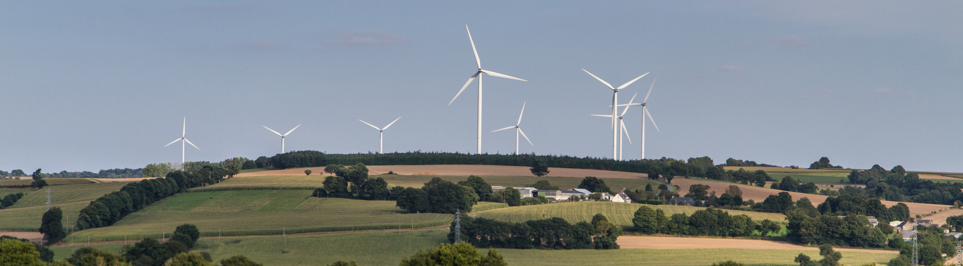
Flagship project La Ferrière, France
In 2014 we commissioned eight wind turbines in La Ferrière, France. The greatest challenge was mastering the “installations
classified for the protection of the environment” (ICPE) procedure, which was also new in that country. Besides preliminary checks to determine how a facility affects the environment, it calls for extensive questioning of local residents.
This success was achieved thanks to good cooperation with the agency that issues the required permits and to the
Considerable experience of our French subsidiary, P&T.

Slide 19
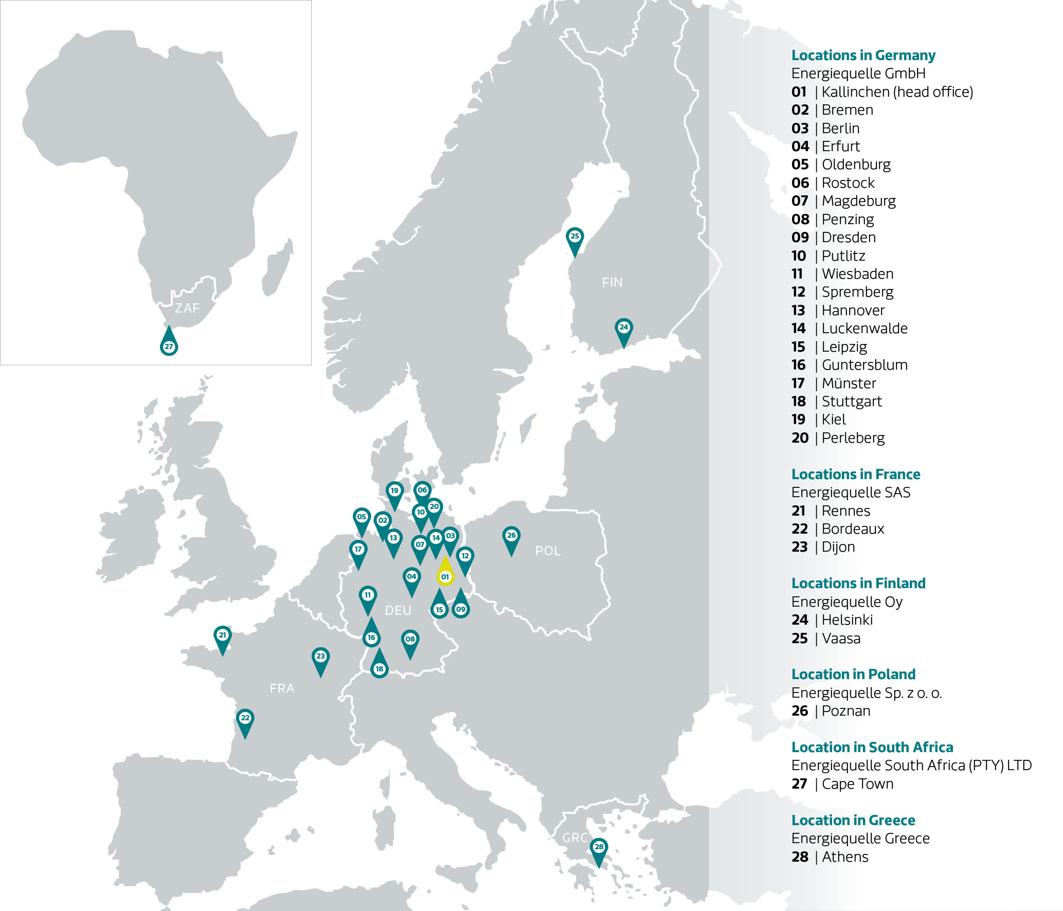
Our Office
Locations
Germany
France
Finland
Poland
South Africa
Greece

Slide 20
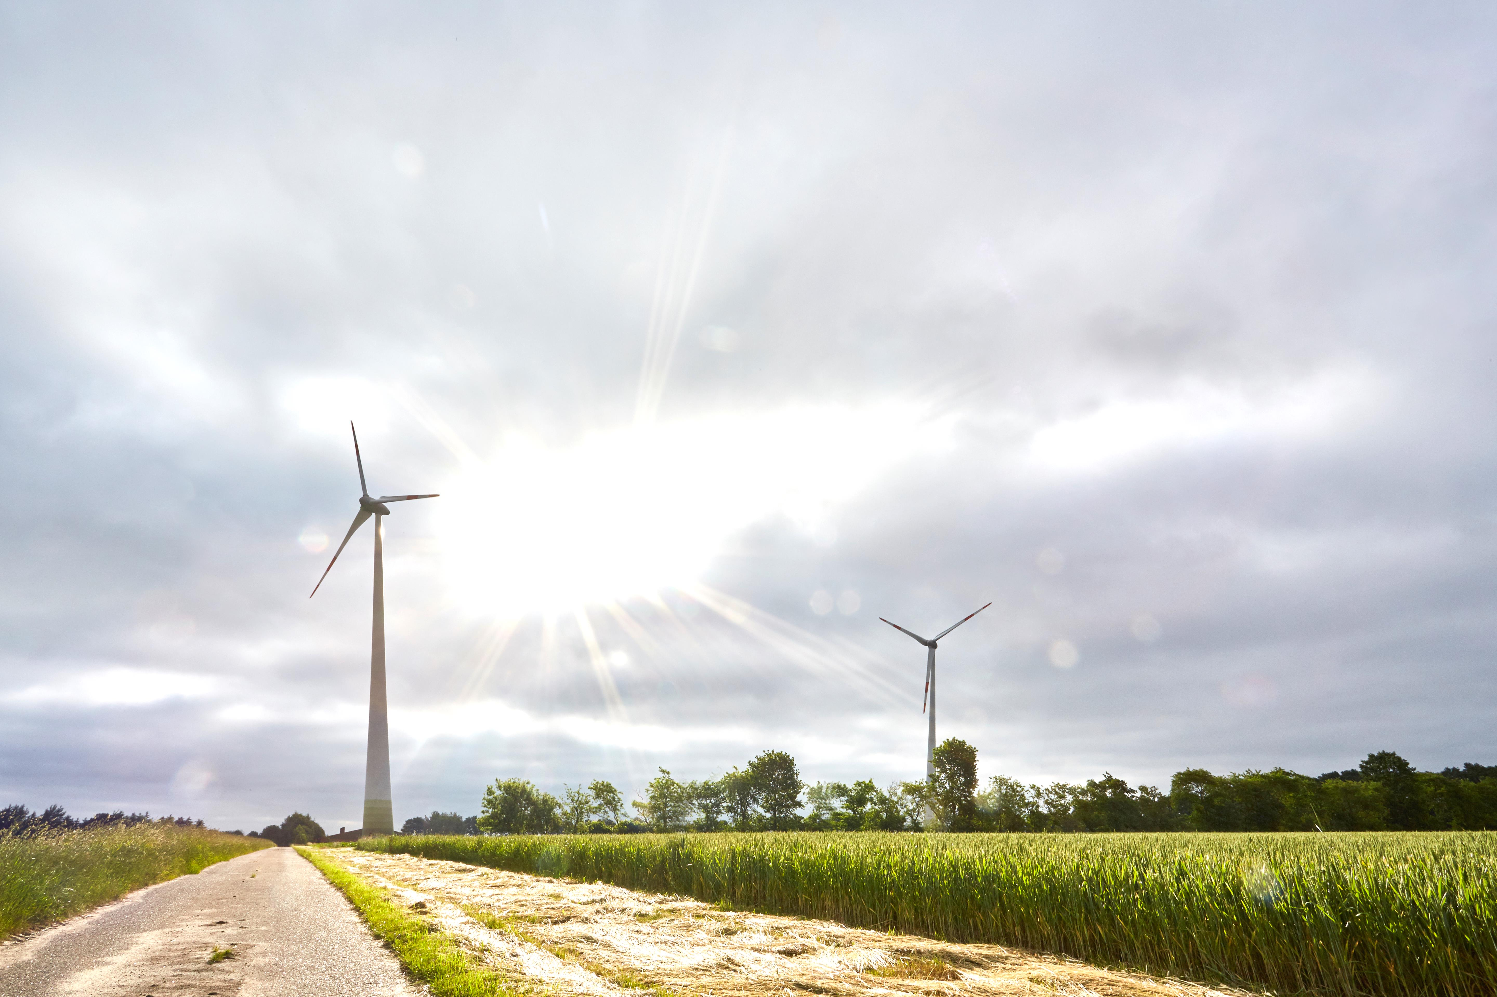
We are your Energy.
With a Future.
Energiequelle GmbH
Hauptstr. 44
15806 Zossen OT Kallinchen
T +49 33769 871 0
info@energiequelle.de
www.energiequelle.de

